Slide 1
Snake And Apples Game
Done By:
Hassan Termos
Yara El Omeiri

Slide 2
General Overview
This project is a simple snake game , however to break the routine and make it more challenger new features were added.
Importance of the Project:
Learning Programming Concepts(Breaking down the game into functions and classes.
Managing user inputs (keyboard or mouse).
Using lists to store the snake's body segments).

Slide 3
Design and Structure
Game Components:
Snake
Food Items
Power-Ups
Obstacles
Main Functionalities:
Movement
Growth
Random Placement for apples
Consumption and increasing score
Collision Detection and score decreasement

Slide 4
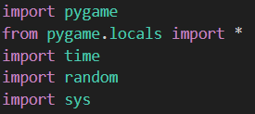
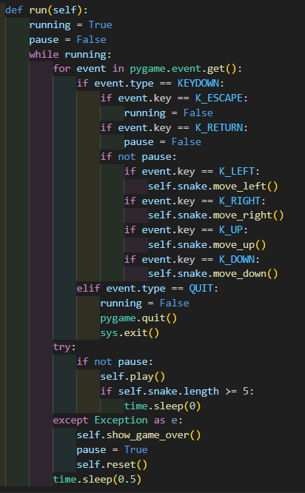
Coding
Key Sections of Code:
Initializing Pygame and Setting Up Display
Handling User Input and Game Logic

Slide 5
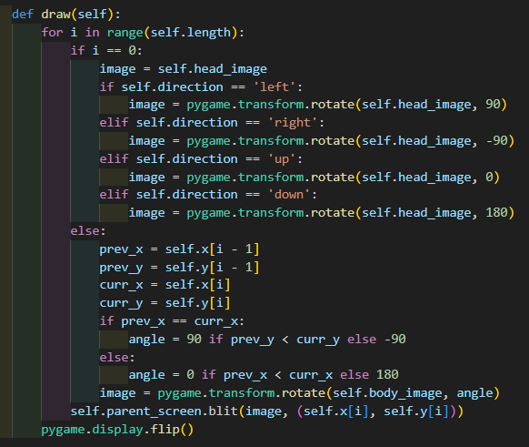
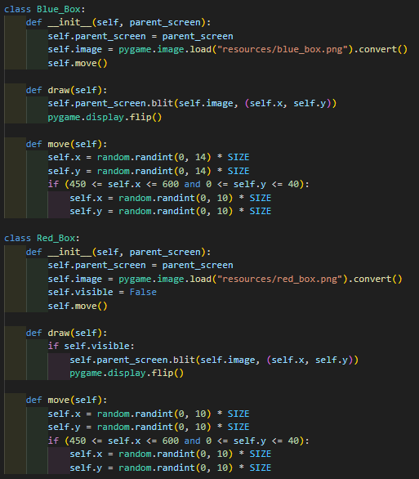
Coding
Key Sections of Code:
Implementing New Features

Slide 6
Problem Statement and Solution Approach
Issues Encountered:
Overlapping Red Box and Blue Box
Collision Detection
Handling Game Over Conditions

Slide 7
Problem Statement and Solution Approach
Preventing Overlapping Boxes:
Modified the ‘move’ methods for ‘Red_box’ and ‘Blue_box’
Implemented checks to ensure the new box positions do not collide with existing ones.
Collision Detection:
Implemented methods to check for collisions between the snake and boxes.
Handled collision scenarios to increase or decrease snake length accordingly.
Handling Game Over Conditions:
Detected border collisions and collisions with the snake's own body.
Displayed a game over screen with the player's score and options to restart or exit the game.

Slide 8
Conclusion and Summary
Some Conclusions:
Successfully Implemented Snake Game with Additional Features.
Addressed Various Programming Challenges.
Applied Object-Oriented Programming Principles.
Enhanced Problem-Solving Skills.
Summary:
The Snake game project successfully implemented a classic game with additional features, and applying object-oriented programming principles . We include improved problem-solving abilities, enhanced game development skills, and a focus on user engagement through responsive interfaces and enjoyable gameplay. Moving forward, potential avenues for further development include adding new features and exploring opportunities for future enhancements.

